Slide 1











Slide 2
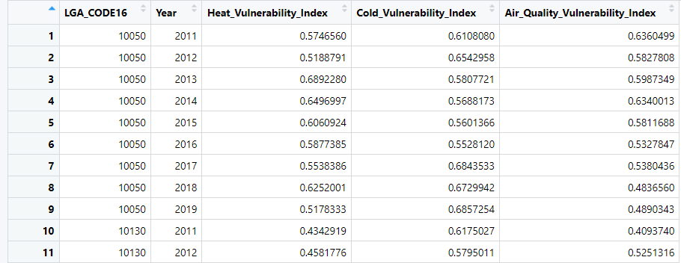
Resources:
We provided national heat, cold, and air quality vulnerability indices.
Local Government Area Resolution
(ASGS2016)
Month / Year / Week Temporal Resolution
2011-2019
Temporal Extent

Slide 3
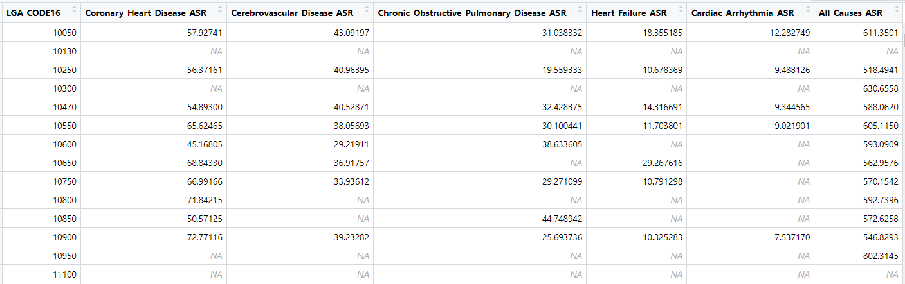
We’re providing mortality data; national averages from the Australian Institute of Health and Welfare.
Local Government Area Resolution
(ASGS2016)
Single Time Point
(5yr Averages)
Missing Data Entries

Slide 4
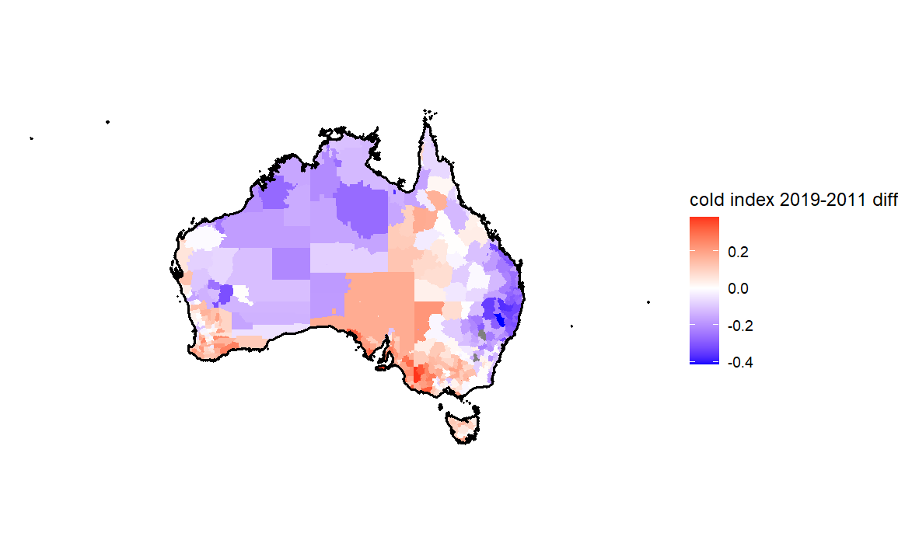
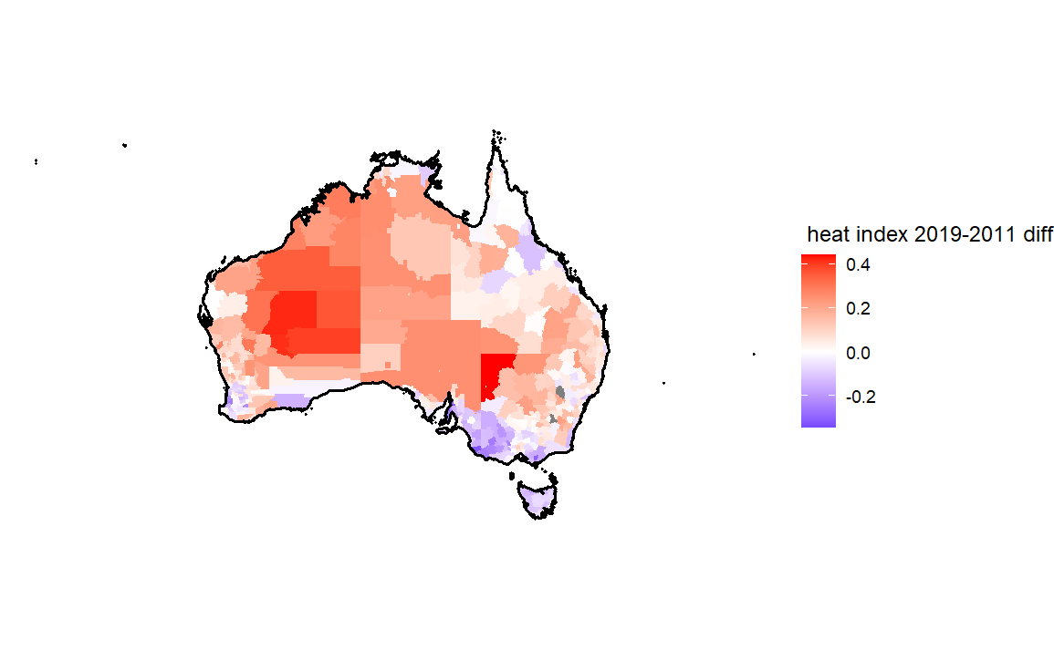
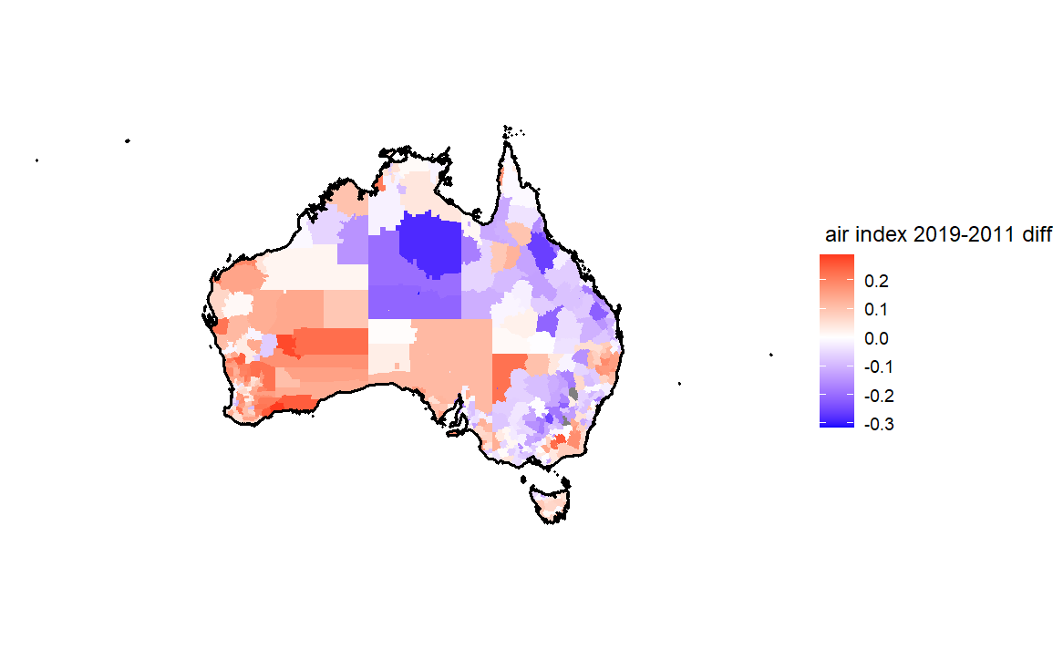
Differences Over Time

Slide 5
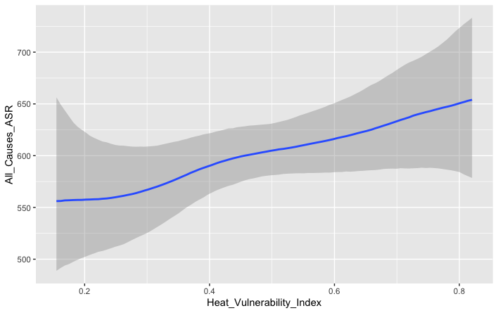
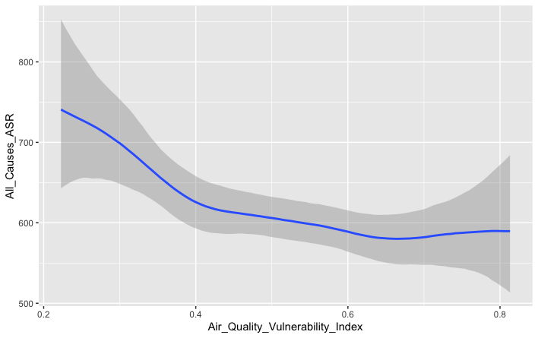
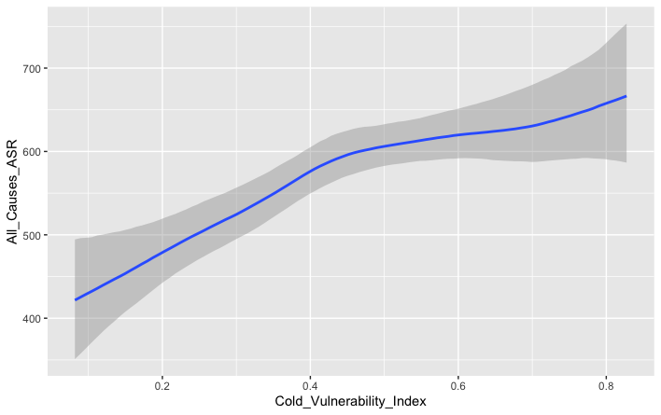
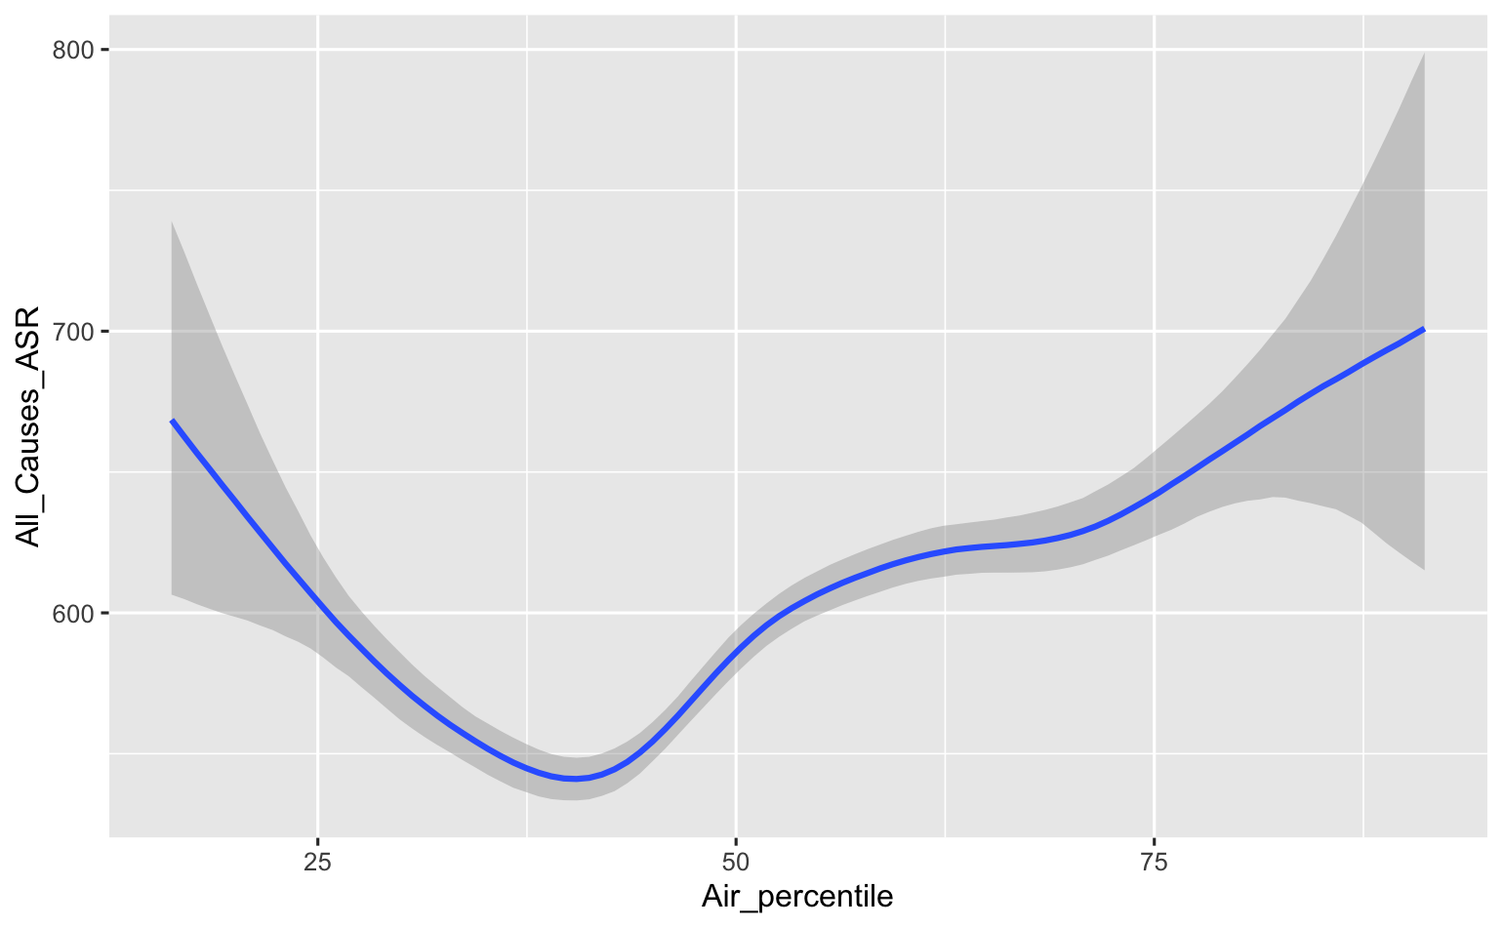
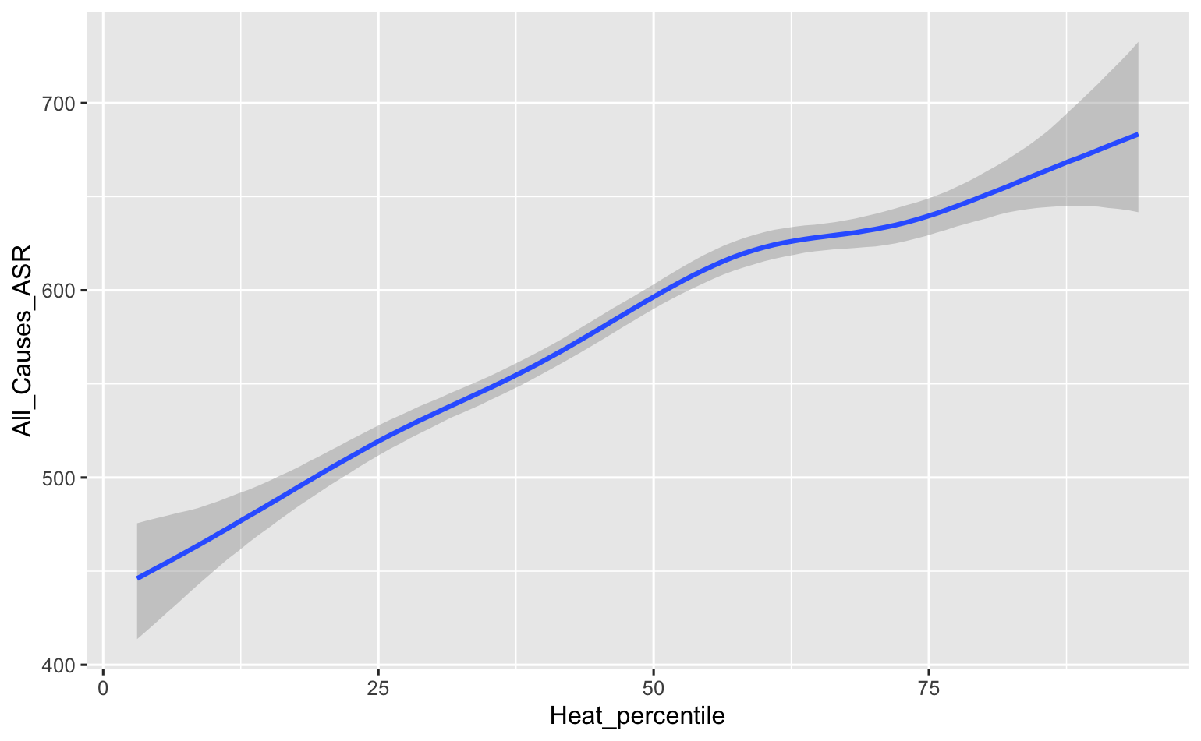
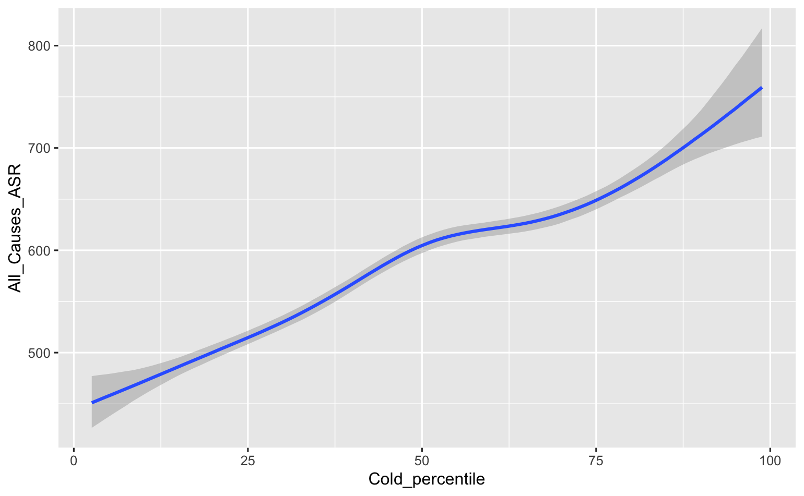
Modelling Using BRMS
Including all 3 indices washes out effect of air quality – likely collinearity (Bayesian regression with log-normal prior)
all_three_mod <- brms::brm(All_Causes_ASR ~ s(Heat_percentile) + s(Air_percentile) + s(Cold_percentile) , data = combo_df_year, family = lognormal(), chains = 4, warmup = 1000, iter = 2000)
Instead, presented one model for each index:
heat_mod <- brms::brm(All_Causes_ASR ~ s(Heat_percentile) , data = combo_df_year, family = lognormal(), chains = 4, warmup = 1000, iter = 2000)

Slide 6
Potential Next Steps
Tease out collinearity between Air Quality VI and Heat/Cold VI
Include random effects in the model
Consider spatial effects (e.g., CAR priors)
Use ARIA+ as a covariate in the model
Explore clustering and temporal patterns further
Compare quintiles across variables and across time.

